Slide 1
A FAULT TOLERANCE TECHNIQUE FOR COMBINATIONAL AND SEQUENTIAL CIRCUITS USING TRIPLE MODULAR REDUNDANCY TECHNIQUE
PHASE II
Under Guidance Of Presented By C.SENTHILKUMAR(AP/ECE) G.SRIPATHI
AVS ENGINEERING COLLEGE (620116419018)
SALEM M.E VLSI DESIGN

Slide 2
Objective
To focus on designing combinational & sequential circuits for error tolerance with minimal area overhead.

Slide 3
Abstract
Analyzing random pattern testability of faults in a circuit and protecting sensitive transistors.
Duplicating and sizing a subset of transistors necessary for providing the protection.
Protect sensitive transistors whose probability of failure is relatively high and compute the circuit failure rate at the gate level.

Slide 4
Introduction of Fault Tolerance Technique
Fault-tolerant techniques using hardware redundancy have been extensively investigated for improving reliability.
Due to advancements in CMOS technology and shrinking of feature size to the nanometer scale systems are turning out to be more susceptible to manufacturing defects and soft errors.

Slide 5
Literature Review
S. NO | TITLE | AUTHOR NAME | YEAR | DRAWBACK
1 | Soft N Modular Redundancy | Eric P.Kim, Naresh R.Shanbhag | 2012 | The Quality and Power efficiency is Low.
2 | A Fault Tolerant Technique Using Quadded Logic and Quadded Transistors | Jie Han, Eugene Leung, Leibo Liu, Fabrizio Lombardi | 2014 | Reliability is very low for smaller circuits.
3 | Simulation Based Method for Synthesizing Soft Error Tolerant Combinational Circuits | Aimen H.El-Maleh, Khaled A.K.Daud | 2015 | It is only for Combinational circuits. Multi level circuits takes some time delay

Slide 6
Existing System
They Focused on designing combinational circuits for soft error tolerance with minimal area overhead.
Transistors are protected based on duplicating and sizing a subset of transistors necessary for providing the protection.

Slide 7
Selective Transistor Redundancy Technique
The Selective Transistor Redundancy technique is applied to protect the transistors of a circuit that have relatively high Probability of failure.
Different arrangements of nMOS and pMOS transistors are discussed for each gate for various transistor protection scenarios.

Slide 8
Disadvantage
Which has an area overhead of at least three times the area overhead of the original circuit.
Significantly More area overhead with similar reliability measures.

Slide 9
Proposed System
An alternative way to have a fault less system Triple Modular Redundancy (TMR) is used for making a fault tolerance.
By using this TMR model, the faulty processor is detected as well as the administrator will be able to know that fault lie in which bit of which processor.

Slide 10
Block Diagram of TMR

Slide 11
Block Diagram Explanation
A TMR system is composed of three identical devices and voting logic.
The voting logic is the majority voter which takes the majority of inputs to be the output value.
Due to the fault in system, one of these three devices may have an error inside and generate a different output.

Slide 12
Software Utilization
Modelsim
Altera Quartus II

Slide 13
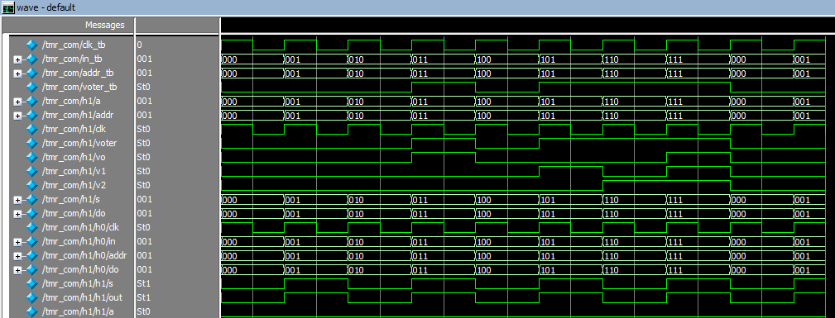
Simulation Results
Multiplexer Output:

Slide 14
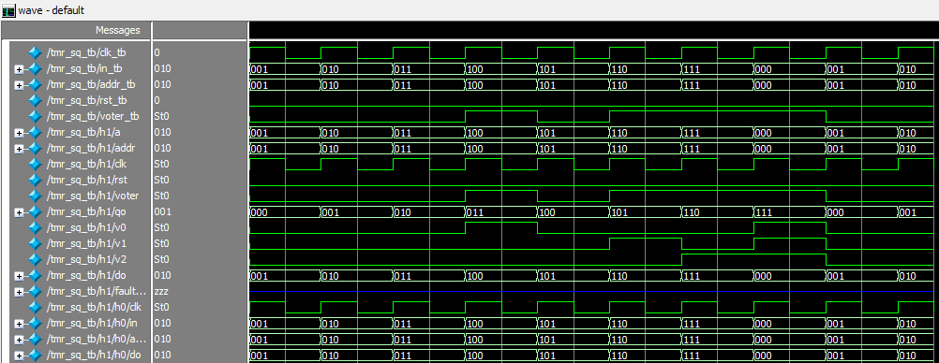
DFF Output:

Slide 15
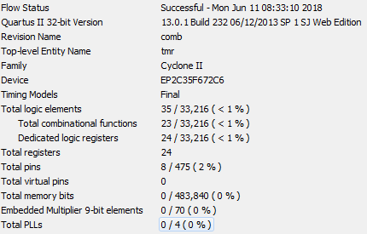
Synthesis Results
Area Report:

Slide 16
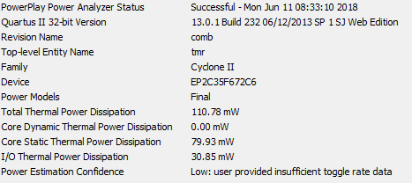
Power Dissipation Report:

Slide 17
Conclusion
An STR-based fault tolerance technique for combinational circuits have been studied with literature papers.
This system evaluates the processor and checks for the faulty bits in the processor.
TMR administrator will come to know which of the processor is diverting from regular program and they will able to take the appropriate action based on the results.

Slide 18
References
1. A. H. El-Maleh and K. A. K. Daud, (2015), “Simulation-based method for synthesizing soft error tolerant combinational circuits,” IEEE Trans. Rel., vol.64, no. 3, pp. 935–948.
2. A. H. El-Maleh and F. C. Oughali, (2014), “A generalized modular redundancy scheme for enhancing fault tolerance of combinational circuits,” Microelectron. Rel., vol. 54, no. 1, pp. 316–326.
3. C. Lazzari, G. Wirth, F. L. Kastensmidt, L. Anghel, and R. A. da Luz Reis, (2012), “Asymmetric transistor sizing targeting radiation-hardened circuits,” Elect. Eng., vol. 94, no. 1, pp. 11–18.

Slide 19
4. Chris Winstead, Yi Luo, Eduardo Monzon, and Abiezer Tejeda, (2011) “An error correction method for binary and multiple-valued”.
5. E. P. Kim and N. R. Shanbhag, (2012) “Soft N-modular redundancy,” IEEE Trans. Comput., vol. 61, no. 3, pp. 323–336.
6. J. Han, E. Leung, L. Liu, and F. Lombardi, (2015), “A fault-tolerant technique using quadded logic and quadded transistors,” IEEE Trans. Very Large Scale Integr. (VLSI) Syst., vol. 23, no. 8, pp. 1562–1566.

Slide 20
THANK YOU

